Slide 1
Neeley Analytics Initiative
Dr. Justin Keeler
Clinical Associate Professor of Data Analytics
Neeley School of Business

Slide 2
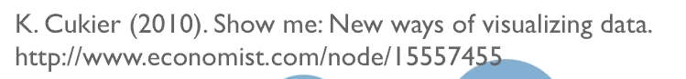
As visualization designers, we are “melding the skills of computer science, statistics, artistic design and storytelling.”

Slide 3
Visualization is a Translation Process
Real World
Data
Visual Design
Stories

Slide 4
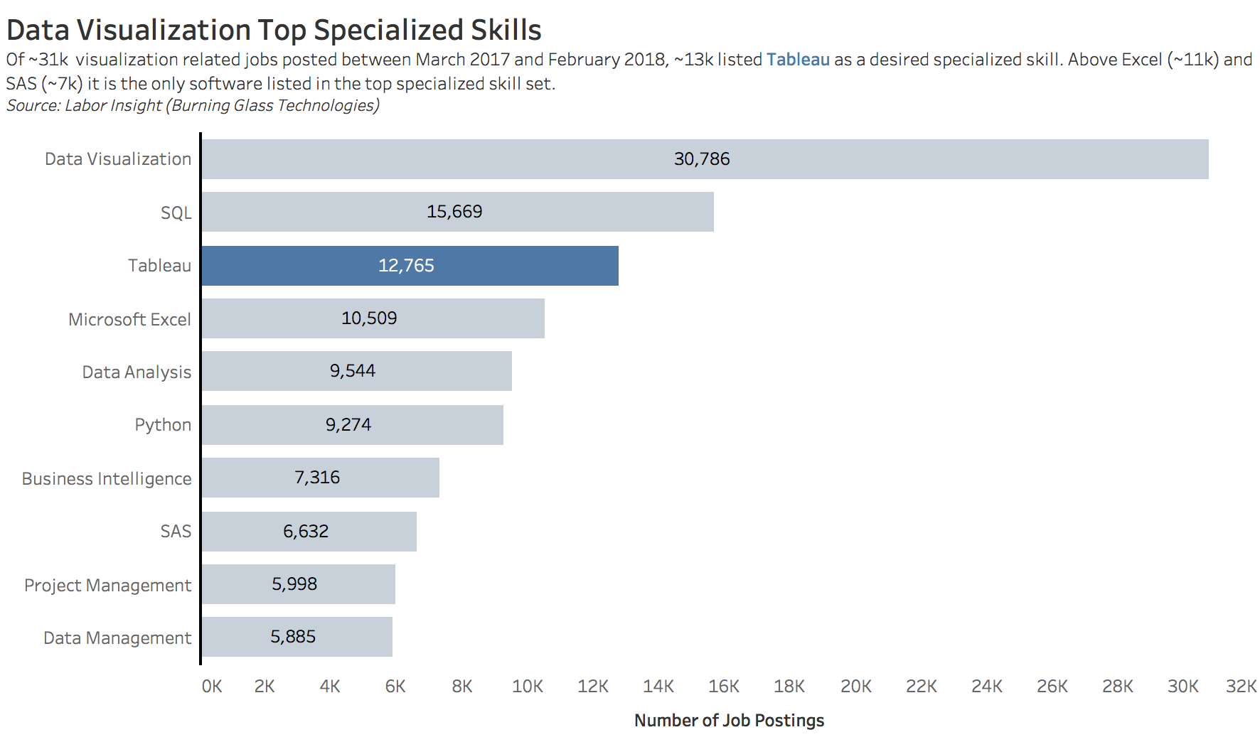
Why Tableau
Approximately half of the jobs posted in the last year that asked for data visualization skills specifically asked for Tableau
Notes:
Based on an IEEE paper by Ryan (2019)

Slide 5
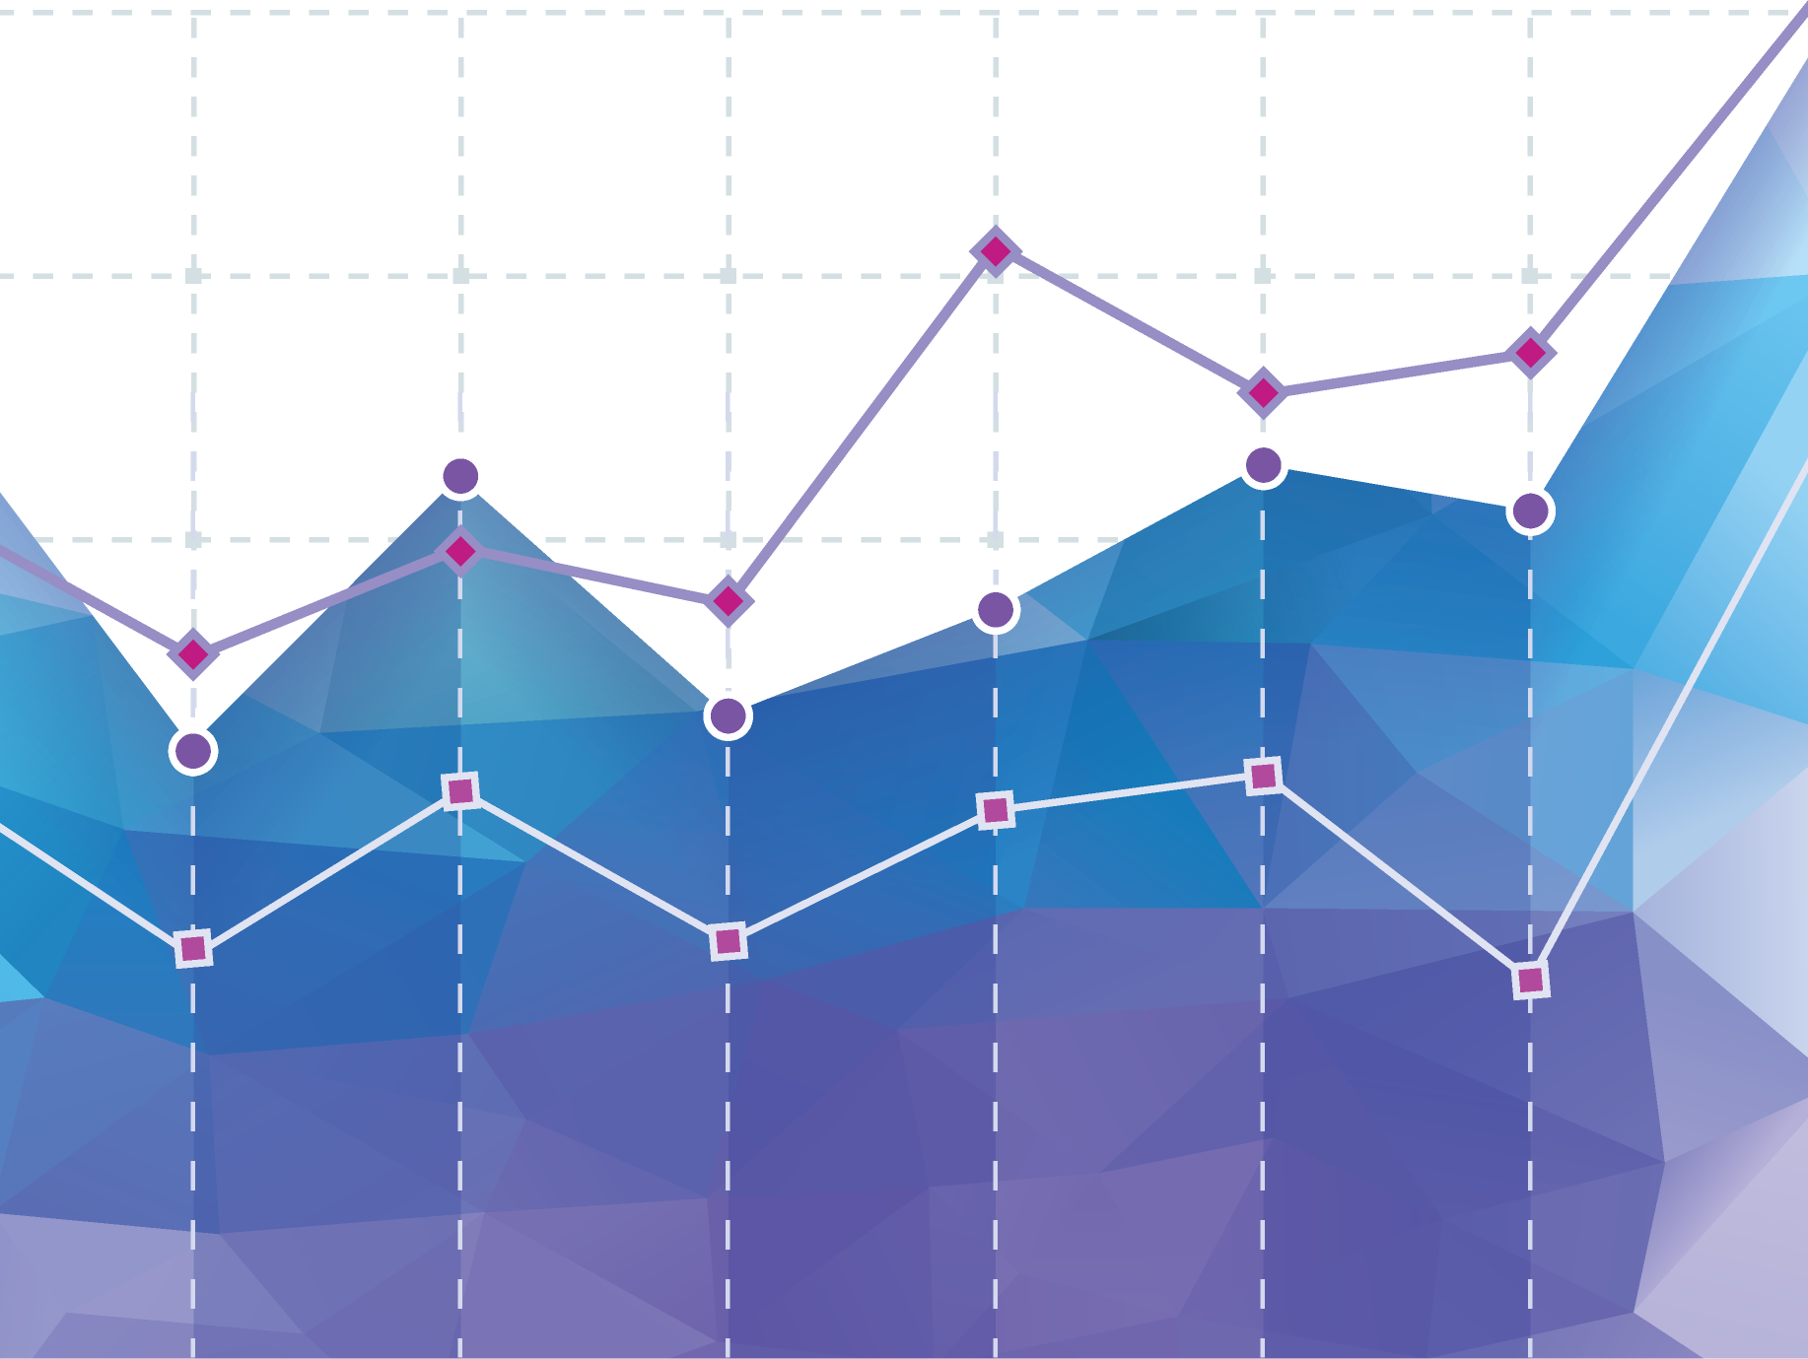
Definition of Data Visualization
Data Visualization is the practice of representing data visually.
Notes:
Increasingly interactive, mobile, and engaging ways – be these in traditional charts, graphs or more advanced types of graphs, or even something like infographics

Slide 6
Four Use Cases for Data Visualization
To Record
To Analyze & Reveal
To Confirm
To Communicate
Notes:
To record something / have a graphic record of something.
To analyze data, reveal trends and patterns, and support reasoning.
To confirm a hypothesis about data through data discovery and exploration.
To communicate insights or findings about data.

Slide 7

To transform information with the influence of purposeful design and analytics with the intent of encoding and conveying information otherwise difficult to understand in a meaningful way.
Notes:
To transform information with the influence of purposeful design and analytics with the intent of encoding and conveying information otherwise difficult to understand in a meaningful way.

Slide 8
Categories of Data Visualization
Exploratory
Explanatory
Hybrid

Slide 9
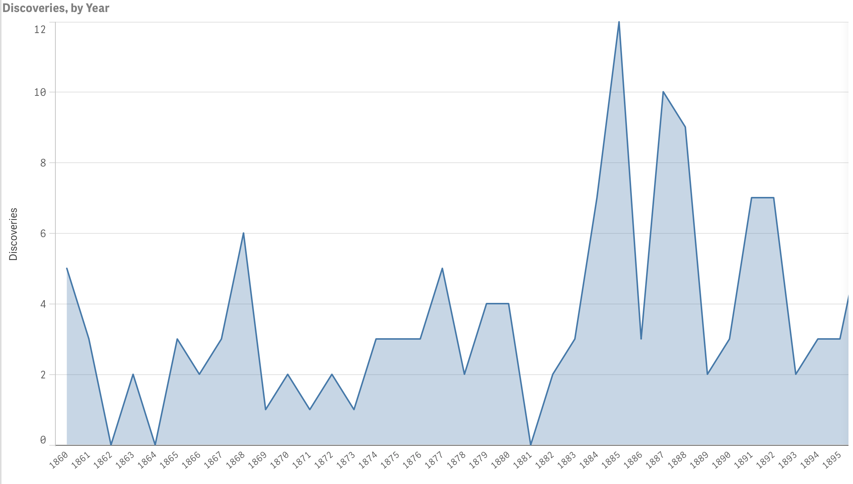
Exploratory
scroll
Notes:
Intended to Explore – goal as analyst are to explore data and find something to tell
Curiosity Driven
Messy, interactive
Pose new questions
Discover something
Cyclical, iterative

Slide 10
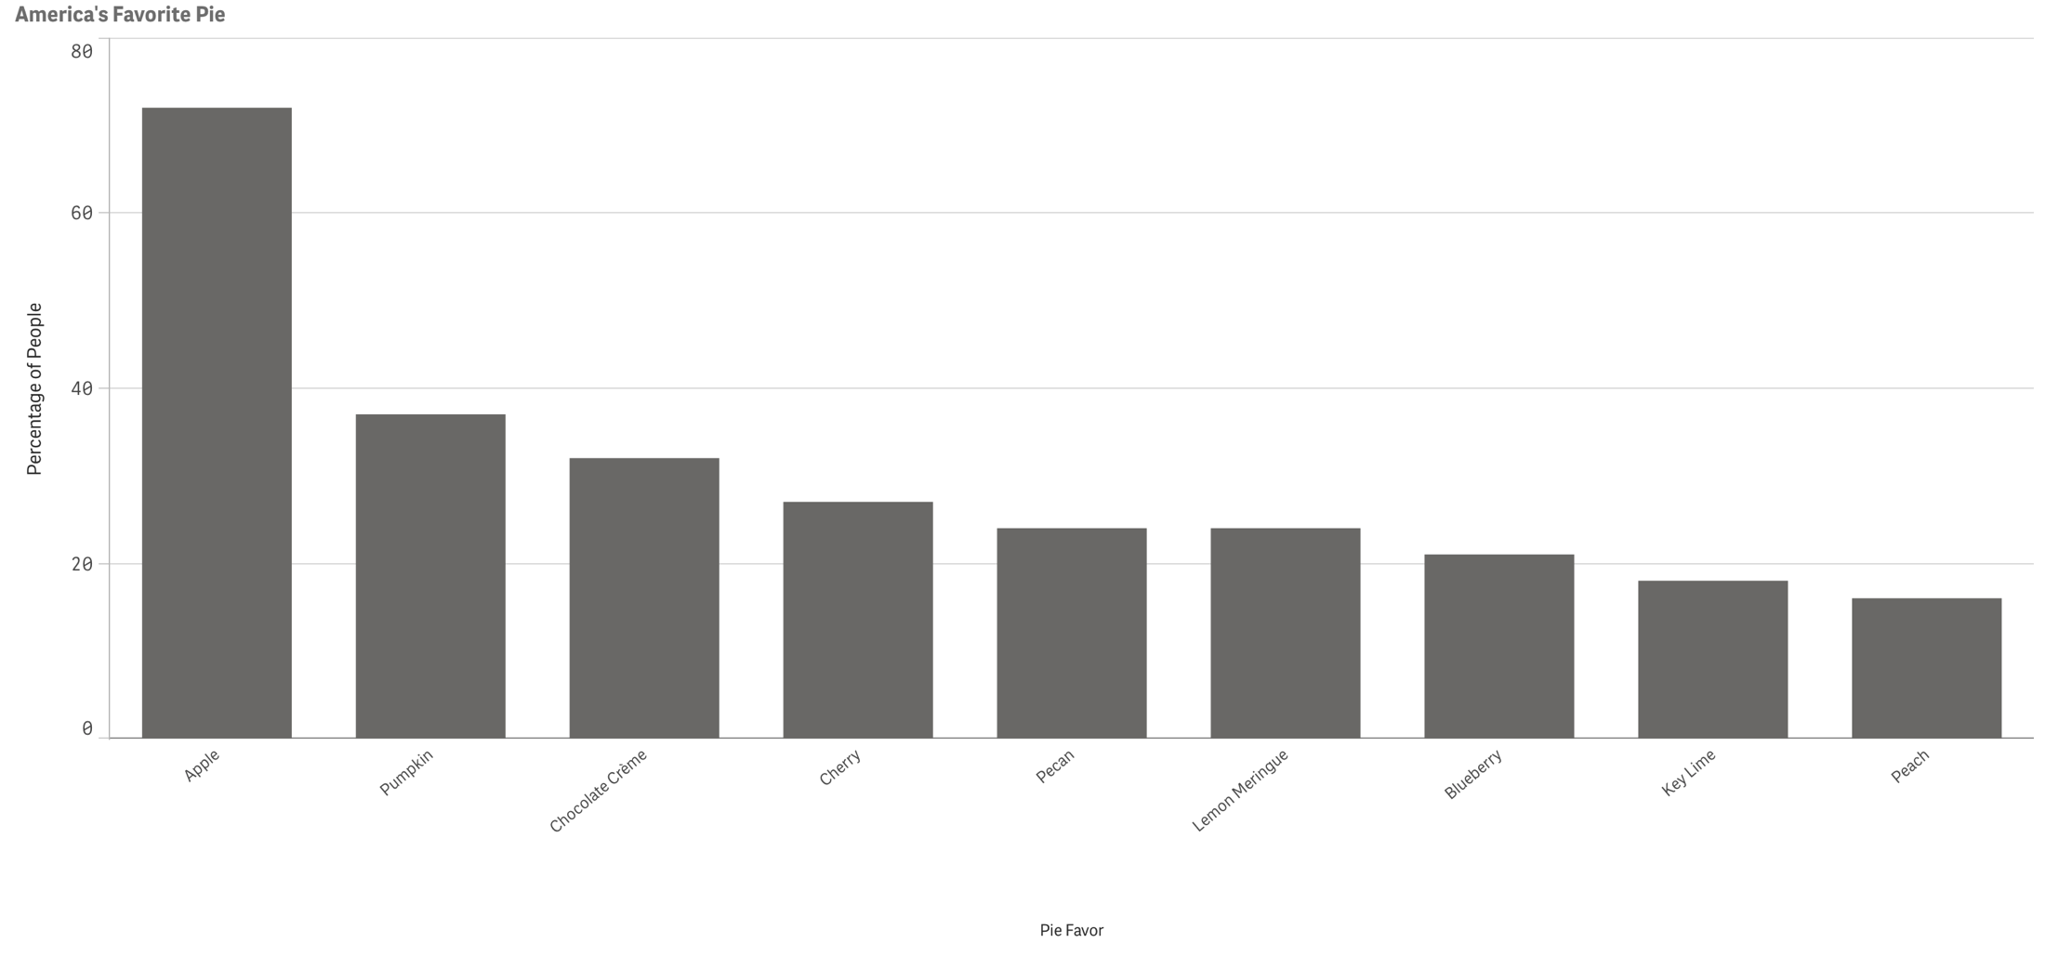
Explanatory
Notes:
Intended to Explain – goal as data storytellers is to communicate what we find
Answer a question
Prove a point
Support a decision
Communicate information
Increase efficiency

Slide 11
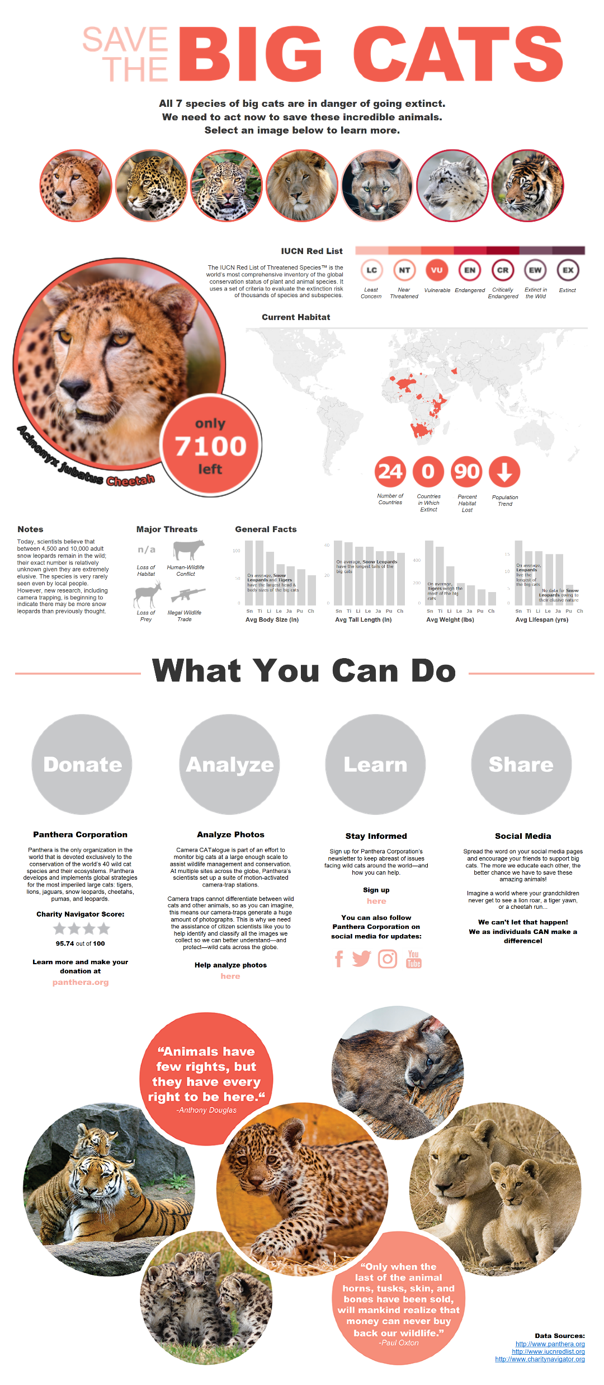
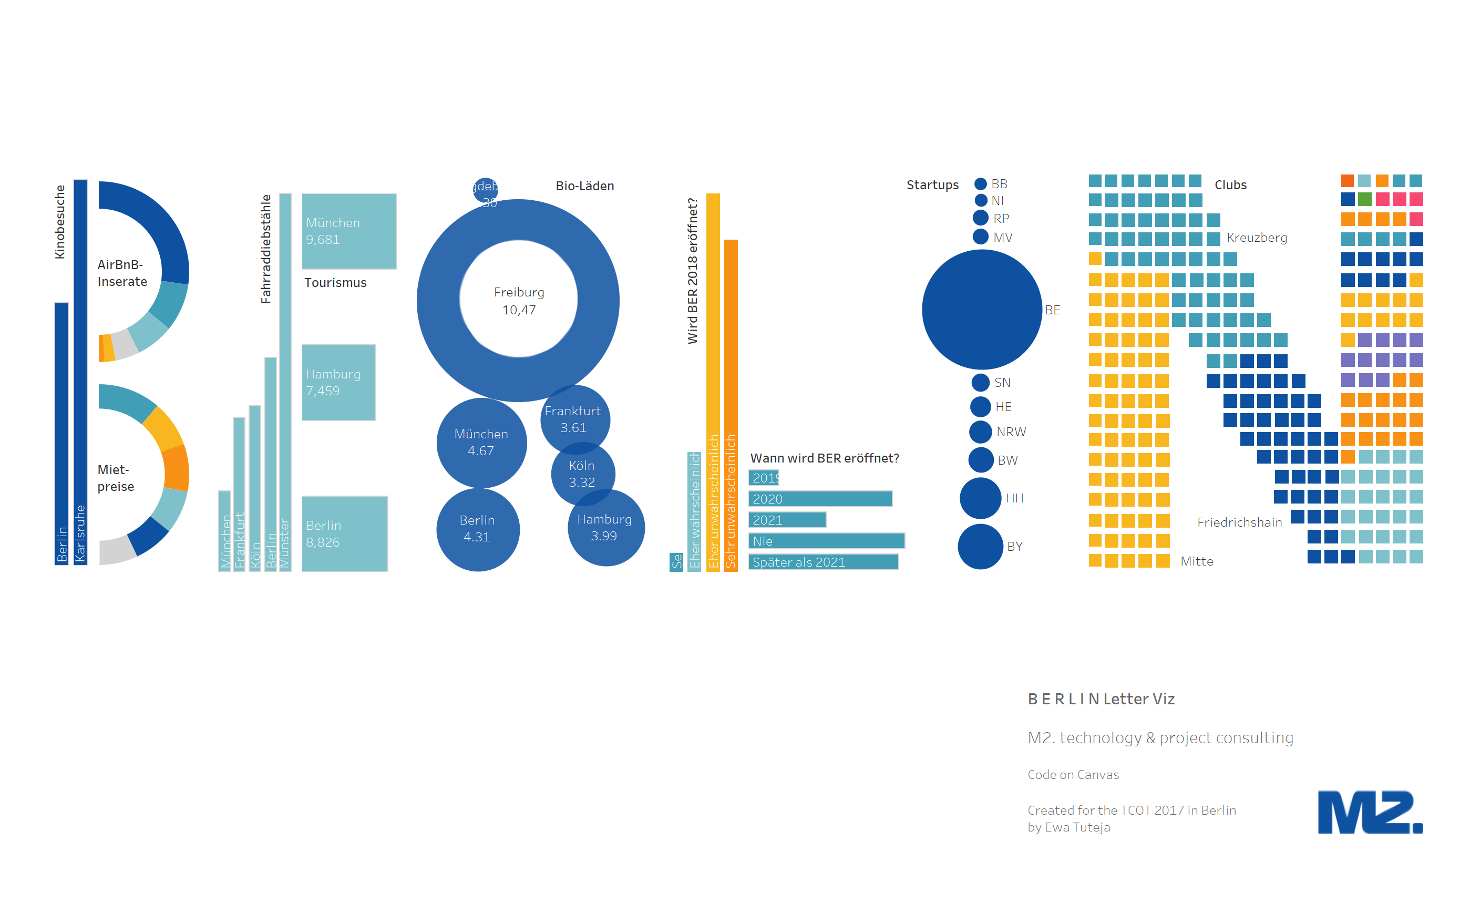
Hybrid
Notes:
Hybrid visualiztaions often include things like infographics—and you might be surprised to find out that these graphics were actually made with Tableau
Offer a curated view of information that has many things to learn, and may have some interactive capabilities—sort of like a choose your own adventure book ( click here, see this, click there, see that)

Slide 12
Data Quality
Why do we care about data quality in this class?
Notes:
NOTE:
The purpose of this section is to show the importance of good data quality. Garbage in is garbage out. There are examples of real-world data issues encountered as well as the fundamental concepts around data modeling.

Slide 13
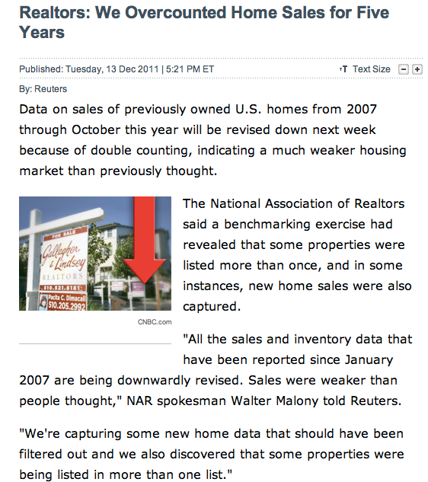
Be Vigilant: Question the Data
Notes:
Here is a press release from 2011. This is after the financial crisis which was driven primarily by a mortgage crisis. The National Association of Realtors, known as they NAR, has some of the best economists in the world constantly studying and publishing about the real estate market. Their numbers are published regularly and the market uses those numbers as a common guide for how things are in the housing market. But there’s a major issue here. In December 2011, they announced that they had found an error in their numbers. As it turns out it was a major error. From 2007, pre-recession, through the end of 2011 they were double counting sales of certain homes. As a result, they had to revise all of their sales numbers down. How did this happen? How did an organization with world-class talent make a mistake like this?
The data for the homes sales is collected in the Multiple Listing Service, or MLS. These MLS systems across the country gather and report the data for their area. The issue arises when homes are on the borders of the MLS. There were homes entered into two or more MLS systems, so that when the house was reported as sold, it was reported by more than one MLS system and double counted.

Slide 14
The Data Quality Challenge!
The cost of bad data exceeds $600B for US businesses annually
Nearly 50% say data quality is the greatest barrier to realizing value from business analytics
Poor data has been cited as the number one reason for project overruns
For a medium sized Fortune 1000 company, a 10% increase in data usability would increase revenue by $2B
Notes:
The lesson here is “Never Trust the Data”. If you want to be more precise about that statement, you could, “Never trust the assumption of the data.” If you are tasked with looking at data, you have to challenge it, question it, question the source, dig in and explore that data. Remember John Tukey, the guy that invented the box plot. He also invented the idea of Exploratory Data Analysis, or EDA. EDA can help you find insight into the data, but it can also help you explore the quality and veracity of the data.

Slide 15
Good data is clean, relevant, trusted, and can be leveraged.

Slide 16
The Data Quality Challenge!
Question: Where do my highest value subscribers live?
Database Field | Source #1 | Source #2 | Source #3
City | Cinainnati | Cincinnati | Cincinnatti
State | Ohio | OH | O
Cincinnati and Ohio will show up as three different locations.
Question: Which subscribers should I try to reactivate?
Customer Name | Address | Phone | Email
John Smith | 123 Lovely Lane | (513) 456-7890 | jsmith@hotmail.com
J Smith Jr. | 123 Lovely Lane | (513) 602-1234 | jsmith@hotmail.com
John Smith | 123 Lovely Lane #2 | (513) 602-1234 | coolguy@gmail.com
The database will treat these records as separate individuals. Are they?

Slide 17
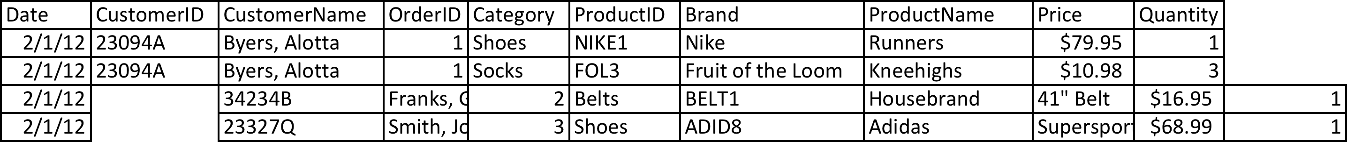
The dangers of Excel as a database Many businesses use Excel to store their data. This can lead to disasters!
Disaster #1: Copy/Paste Errors
When copy/pasting data into Excel, it’s easy to miss the target or overwrite the wrong cells.

Slide 18
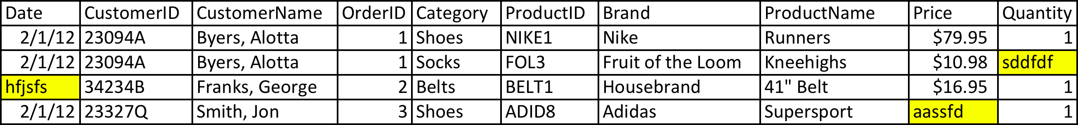
The dangers of Excel as a database Many businesses use Excel to store their data. This can lead to disasters!
Disaster #2: Mixed-up data types
Excel doesn’t enforce consistent data types in each column; this can lead to problems in loading for analysis.

Slide 19
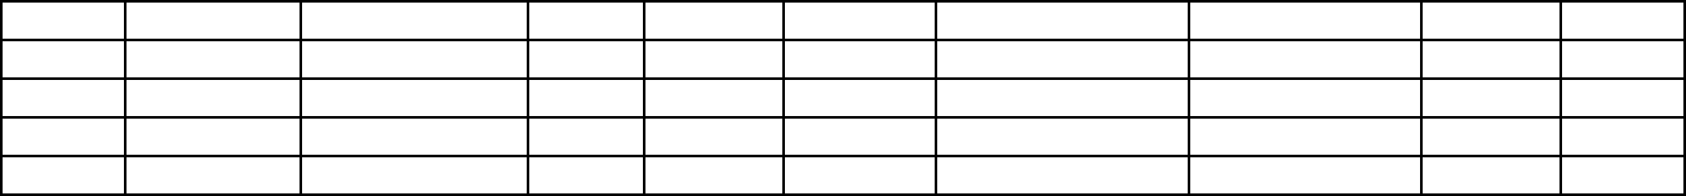
The dangers of Excel as a database Many businesses use Excel to store their data. This can lead to disasters!
Disaster #3: Ooops. Deleted it.
It’s easy to mix up or lose track of which version is right.

Slide 20
Creating a Good Data Set Technical Challenges

Slide 21
Analytical Data Modeling
Two fundamental building blocks:
Dimensions = made up of textual attributes
Not countable
Can be used to group, filter, and build hierarchies
Measures = numeric facts
Countable
Typically additive
Select sum(Sales) where Region = “East” group by State order by State
Notes:
Dimensions and measures (or facts) are the fundamental building block for data analysis. (Note: Tableau also organize the data by dimension and measures). Dimensions might be categories or segments, or regions of the country, for example, north, south, east and west. Measures might be sales, profit, inventory, graduation rate or simple a count of the number of people or things in the data.
In a database query we see the dimension used as a group by or filter. In the example at the bottom, the query selects the sum of a measure, which is sales, filters by the dimension Region and then groups and orders by another dimension of State.

Slide 22
Let’s simplify
For a data set that works well in both Excel and Tableau, create a single table that contains all the attributes and measures to analyze…
Date | CustomerID | CustomerName | OrderID | Category | ProductID | Brand | ProductName | AgentID | AgentName | Price | Quantity
2/1/12 | 23094A | Byers, Alotta | 1 | Shoes | NIKE1 | Nike | Runners | 101 | Pay, Freda | $79.95 | 1
2/1/12 | 23094A | Byers, Alotta | 1 | Socks | FOL3 | Fruit of the Loom | Kneehighs | 101 | Pay, Freda | $10.98 | 3
2/1/12 | 34234B | Franks, George | 2 | Belts | BELT1 | Housebrand | 41" Belt | 101 | Pay, Freda | $16.95 | 1
2/1/12 | 23327Q | Smith, Jon | 3 | Shoes | ADID8 | Adidas | Supersport | 101 | Pay, Freda | $68.99 | 1
2/2/12 | 34634A | Fields, Mary | 4 | Socks | FOL3 | Fruit of the Loom | Anglehighs | 102 | Merkle, Fred | $6.98 | 3
2/3/12 | 34634A | Fields, Mary | 4 | Sandals | KEEN7 | Keen | Desert Walker | 102 | Merkle, Fred | $82.98 | 1
2/3/12 | 34634A | Fields, Mary | 4 | Sandals | KEEN8 | Keen | Night Runner | 102 | Merkle, Fred | $69.98 | 2
2/3/12 | 67657T | Geld, Reginald | 5 | Ties | TIE8 | Housebrand | Yellow Polkadot | 101 | Pay, Freda | $22.79 | 1
2/3/12 | 34543A | Turner, Rod | 6 | Socks | CHMP3 | Champion | Athletic Sport | 101 | Pay, Freda | $7.98 | 4
Which are dimensions and which are measures?
Notes:
[Ask the class to identify which of these are dimensions and which are measures]

Slide 23
Let’s simplify
For a data set that works well in both Excel and Tableau, create a single table that contains all the attributes and measures to analyze…
Date | CustomerID | CustomerName | OrderID | Category | ProductID | Brand | ProductName | AgentID | AgentName | Price | Quantity
2/1/12 | 23094A | Byers, Alotta | 1 | Shoes | NIKE1 | Nike | Runners | 101 | Pay, Freda | $79.95 | 1
2/1/12 | 23094A | Byers, Alotta | 1 | Socks | FOL3 | Fruit of the Loom | Kneehighs | 101 | Pay, Freda | $10.98 | 3
2/1/12 | 34234B | Franks, George | 2 | Belts | BELT1 | Housebrand | 41" Belt | 101 | Pay, Freda | $16.95 | 1
2/1/12 | 23327Q | Smith, Jon | 3 | Shoes | ADID8 | Adidas | Supersport | 101 | Pay, Freda | $68.99 | 1
2/2/12 | 34634A | Fields, Mary | 4 | Socks | FOL3 | Fruit of the Loom | Anglehighs | 102 | Merkle, Fred | $6.98 | 3
2/3/12 | 34634A | Fields, Mary | 4 | Sandals | KEEN7 | Keen | Desert Walker | 102 | Merkle, Fred | $82.98 | 1
2/3/12 | 34634A | Fields, Mary | 4 | Sandals | KEEN8 | Keen | Night Runner | 102 | Merkle, Fred | $69.98 | 2
2/3/12 | 67657T | Geld, Reginald | 5 | Ties | TIE8 | Housebrand | Yellow Polkadot | 101 | Pay, Freda | $22.79 | 1
2/3/12 | 34543A | Turner, Rod | 6 | Socks | CHMP3 | Champion | Athletic Sport | 101 | Pay, Freda | $7.98 | 4
Attributes provide ways to group, organize, categorize, filter, and segment the data…

Slide 24
Let’s simplify
For a data set that works well in both Excel and Tableau, create a single table that contains all the attributes and measures to analyze…
Date | CustomerID | CustomerName | OrderID | Category | ProductID | Brand | ProductName | AgentID | AgentName | Price | Quantity
2/1/12 | 23094A | Byers, Alotta | 1 | Shoes | NIKE1 | Nike | Runners | 101 | Pay, Freda | $79.95 | 1
2/1/12 | 23094A | Byers, Alotta | 1 | Socks | FOL3 | Fruit of the Loom | Kneehighs | 101 | Pay, Freda | $10.98 | 3
2/1/12 | 34234B | Franks, George | 2 | Belts | BELT1 | Housebrand | 41" Belt | 101 | Pay, Freda | $16.95 | 1
2/1/12 | 23327Q | Smith, Jon | 3 | Shoes | ADID8 | Adidas | Supersport | 101 | Pay, Freda | $68.99 | 1
2/2/12 | 34634A | Fields, Mary | 4 | Socks | FOL3 | Fruit of the Loom | Anglehighs | 102 | Merkle, Fred | $6.98 | 3
2/3/12 | 34634A | Fields, Mary | 4 | Sandals | KEEN7 | Keen | Desert Walker | 102 | Merkle, Fred | $82.98 | 1
2/3/12 | 34634A | Fields, Mary | 4 | Sandals | KEEN8 | Keen | Night Runner | 102 | Merkle, Fred | $69.98 | 2
2/3/12 | 67657T | Geld, Reginald | 5 | Ties | TIE8 | Housebrand | Yellow Polkadot | 101 | Pay, Freda | $22.79 | 1
2/3/12 | 34543A | Turner, Rod | 6 | Socks | CHMP3 | Champion | Athletic Sport | 101 | Pay, Freda | $7.98 | 4
Dimensions provide methods to group, organize, categorize, filter, and segment the data
Measures give the quantities and amounts for analysis

Slide 25
Let’s simplify
For a data set that works well in both Excel and Tableau, create a single table that contains all the attributes and measures to analyze…
Date | CustomerID | CustomerName | OrderID | Category | ProductID | Brand | ProductName | AgentID | AgentName | Price | Quantity
2/1/12 | 23094A | Byers, Alotta | 1 | Shoes | NIKE1 | Nike | Runners | 101 | Pay, Freda | $79.95 | 1
2/1/12 | 23094A | Byers, Alotta | 1 | Socks | FOL3 | Fruit of the Loom | Kneehighs | 101 | Pay, Freda | $10.98 | 3
2/1/12 | 34234B | Franks, George | 2 | Belts | BELT1 | Housebrand | 41" Belt | 101 | Pay, Freda | $16.95 | 1
2/1/12 | 23327Q | Smith, Jon | 3 | Shoes | ADID8 | Adidas | Supersport | 101 | Pay, Freda | $68.99 | 1
2/2/12 | 34634A | Fields, Mary | 4 | Socks | FOL3 | Fruit of the Loom | Anglehighs | 102 | Merkle, Fred | $6.98 | 3
2/3/12 | 34634A | Fields, Mary | 4 | Sandals | KEEN7 | Keen | Desert Walker | 102 | Merkle, Fred | $82.98 | 1
2/3/12 | 34634A | Fields, Mary | 4 | Sandals | KEEN8 | Keen | Night Runner | 102 | Merkle, Fred | $69.98 | 2
2/3/12 | 67657T | Geld, Reginald | 5 |  | TIE8 | Housebrand | Yellow Polkadot | 101 |  | $22.79 | 1
2/3/12 | 34543A | Turner, Rod | 6 |  | CHMP3 | Champion | Athletic Sport | 101 |  | $7.98 | 4
Sometimes data is not available, or not applicable
Use (UNK) to mark when
or (N/A) in attribute fields, if applicable

Slide 26
Data Classification
Categorial or Numerical & Measurement Scales
Categorical
Nominal (no specific order of categorical grouping e.g. gender, race, etc.)
Ordinal (specific order e.g. Likert scale)
Numerical (can be discrete or continuous)
Interval (no true zero…can be negative e.g. climate temperature)
Ratio (never goes below zero e.g. weight, body temperature)
Discrete means the countable number of values between any two values e.g.
Number of members in a family
Basketball goals TCU scored and beat OU
Continuous (decimal precision) e.g.
Height or weight of a person

Slide 27
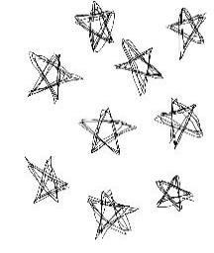
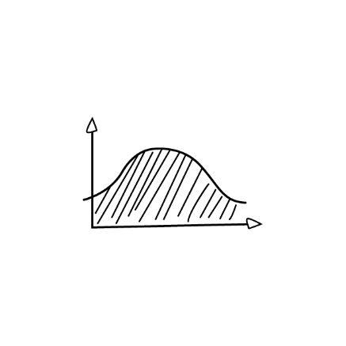



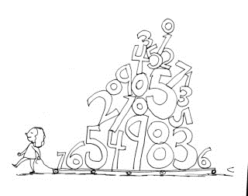

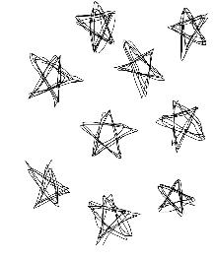
“There is no such thing as information overload. There is only bad design.”
-Edward Tufte
Tableau
90% of surveyed professionals admit to having thrown away information without reading it.
Notes:
Edward Tufte said, there’s no such thing as information overload. There is only bad design.

Slide 28

The Facts
Bad graphs are everywhere
We are not naturally good at storytelling with data
There is a story in your data
The goal is to bring that story visually and contextually to life.

Slide 29
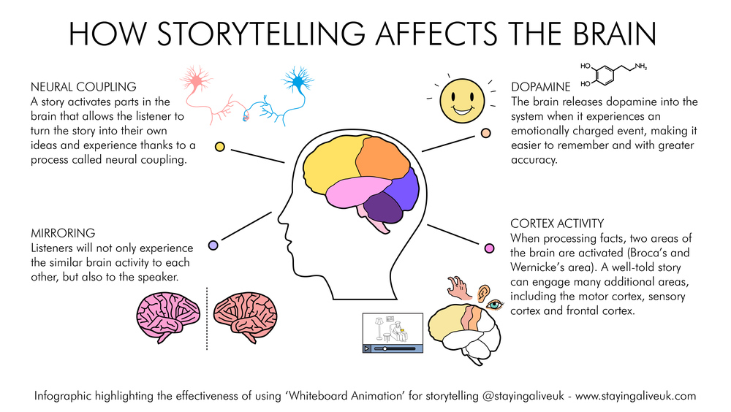
Notes:
There have been scientific studies that have shown that storytelling affects the brain. A story activates parts of the brain that allow the listener to turn the story into their own ideas and experience. Listeners will experience similar brain activity as others and the speaker. In addition, the brain releases dopamine when experiences an emotionally charged event, making it easier to remember and with greater accuracy. And finally, when processing facts, the brain is activated in two primary areas, but when engaged in a well-told story there are many more areas of the brain activated.

Slide 30
Session Focus
Elements of Storytelling
A good story should meet its goals—and it should be actionable.

Slide 31
Elements of Storytelling
Notes:
Let’s look at the elements of storytelling.

Slide 32






Attract
Engage
Punchline
Notes:
At the highest level, we are trying to Attract the audience, Engage with the audience and deliver a Punchline.

Slide 33

Laws of Attraction
Identify theme
Know your audience
Determine purpose
Set the tone
Keep it simple
Notes:
The Laws of Attraction:
Identify the theme. Who’s the audience and what’s the message? Set the tone and keep it as simple.

Slide 34



Rules of Engagement
Interactive vs. non-interactive
Choice of visualizations
Pay attention to size, colors, space
Purposeful arrangement
Walk audience through the story (how you deliver)
Notes:
Rules of Engagement:
Is the viz interactive or static? For the final projects you will be creating an interactive visualization, but as you create visualizations in the future, keep this in mind. What is the best choice for the visualization to display the data? Pay close attention to the use of color, but also size and the use of space. Make sure the arrangement is purposeful.
Walk the audience through the story.

Slide 35


Give ‘Em the Punchline
Conclude clearly
Place your conclusion strategically
Chronologically
Lead with the punchline
Make a lasting impression
Notes:
Make sure the purpose is clear. Step back from your visualization and ask yourself, so what? What is the user supposed to take from your visualization? What purpose did it server? Is that clear? Place your conclusions strategically and don’t be afraid to lead with the punchline. We want to make a lasting impression, but let’s try to do that in a good way.

Slide 36




Notes:
If we look at one of Pixar’s tremendously successful movies, Finding Nemo, we see exactly that. The punchline is in the title of the movie. It’s about, “Finding Nemo”. But the movie doesn’t simply show Nemo lost and then found. Instead, it’s about the long journey it takes to find Nemo.

Slide 37
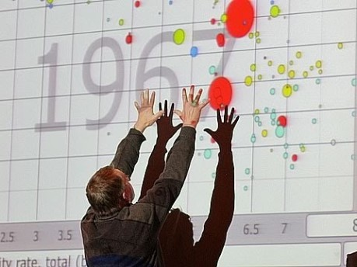

Slide 38
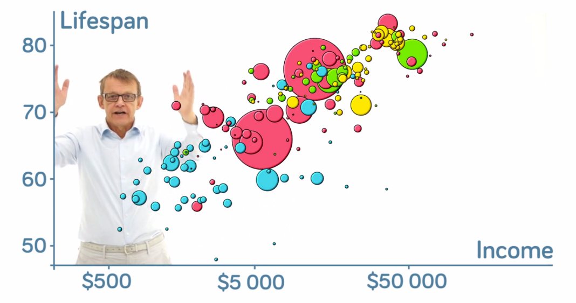
“The Best Stats You’ve Ever Seen”
Notes:
In Module 7, we watch Hans Rolsing’s TED talk and we built his Gapminder viz in Tableau. Let’s breakdown this amazing talk.

Slide 39






Hans Rosling Presentation Breakdown
Attract
Engage
Punchline
Are we really not smarter than chimpanzees?
Debunk third world myths
Show why preconceived notions are wrong
Animation of countries’ progress over the course of 200 years
Walks us through journey
Highlight key historical events that audience may relate to
We need to have open, searchable databases to allow people to see reality
Promote a fact-based view of the world
Notes:
There is no doubt that Hans Rosling attracts attention right from the beginning. He talks about the students and professors being on par with the chimpanzees and debunks third world myths. He explains that it’s not ignorance, but rather preconceived notions and brings data to the rescue.
He Engages the audience by using animations of the countries and walks us through the journey offering real-time commentary as the chart is animating, and he highlights important aspects of the data that people can relate to.
He states his punchline early, “I realized there was really a need to communicate the data.” And he continues to reference throughout his talk and wraps up the talk, discussing the importance and need for more open data and promoting a fact-based view of the world.

Slide 40
Story Telling with Data
Sometimes the only way to see the story in data is visually.
A good story should meet its goals—and it should be actionable.
A story should change, challenge, or confirm the way you think.
Storytelling evolves—don’t be afraid to try something new.

Slide 41
Session Focus
Storytelling with Data

Slide 42

Building your data story
Understand the context
Choose an appropriate visual display
Eliminate clutter
Focus attention where you want it
Think like a designer
Tell a story

Slide 43
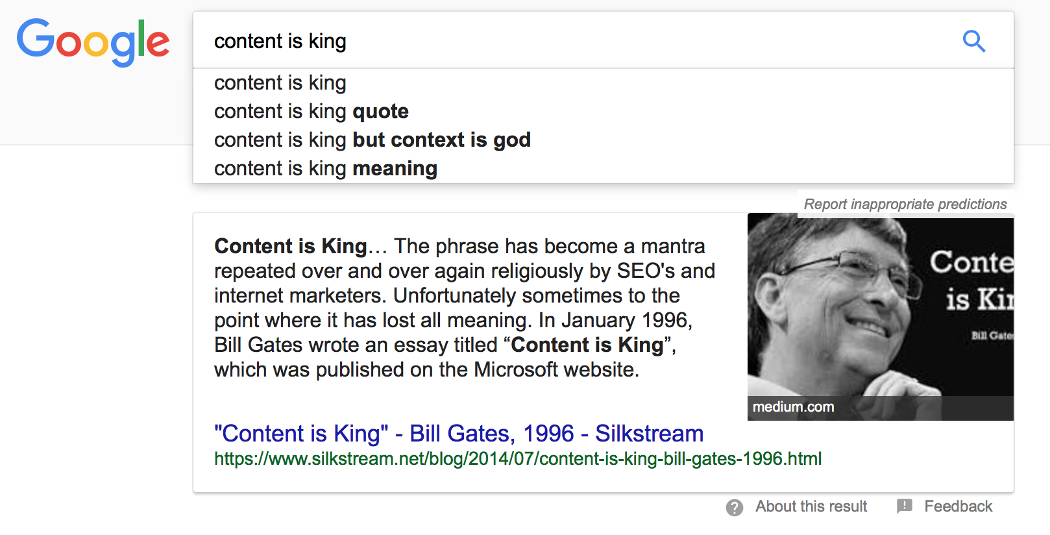
The importance of context
without context [in analytics] data is “meaningless, irrelevant, and even dangerous.”
Notes:
Context is especially important in the field of analytics. Just as communication begins before you ever start building your first data visualization, like any good story, a visual data story requires context—a setting, a plot, a goal—before we can begin to communicate. Discovering this context is part of the storytelling process
In this lesson, we will focus on understanding the importance of context in data visualization and visual storytelling, how to ask the right questions in analysis that will help you begin to build out your story framework, and how to let context drive the story as you share it with your audience.

Slide 44
Context in Action
Context of data
Context of structure
Context of audience
Context of presentation
Context Caution
There’s more to context than just the data
Notes:
The context of a data story is made up of four ingredients:
Context of data.
Context of structure.
Context of audience.
Context of presentation.
Callout: Context Caution
There’s more to context than just the data. Context can also be created by the storyteller or by the audience, based on knowledge, biases, and expectations. A successful storyteller needs to learn how to anticipate these issues. A good way to ensure your context works for you rather than against you is to ask and then answer a series of logically thought out and connected questions about the project, the data, and the audience. The answers to these questions will be a framework for your data story.

Slide 45
Exploratory versus Explanatory Analysis
Exploratory
Insight
Discover hidden patterns
Seek to understand
Explanatory
Answer a question
Support a decision
Communicate information
Notes:
Before we move in to looking at storytelling techniques and story structures, we need to draw a distinction between exploratory and explanatory analysis, and how these contribute to storytelling.
Exploration fuels discovery. It’s the process you take to explore your data and uncover its story. We take time to search, digging in and out of data iteratively and with curiosity as we work to build a story, or perhaps many stories, or perhaps even none at all. Exploration is a process of “look and see,” and we must explore before we can explain.
Our job as analysts is to explore. Our job as data storytellers is to explain. Exploratory analysis may yield important story points, but they are not part of the storytelling process. As storytellers we are focused on explanatory analysis and communicating our discoveries in the form of a story.
The distinction between explanatory and exploratory analysis has an important impact on context, particularly in how we present our results.

Slide 46
Questions to Answer
What background information is relevant or essential?
Who is the audience or decision maker? What do we know about them?
What biases does our audience have that might make them supportive of or resistant to our message?
What data is available that would strengthen our case? Is our audience familiar with this data, or is it new?
Where are the risks: what factors could weaken our case and do we need to proactively address them?
What would a successful outcome look like?
If you only had a limited amount of time or a single sentence to tell your audience what they need to know, what would you say?
Notes:
The 3-minute story & Big Idea
The idea behind each of these concepts is that you are able to boil the “so-what” down to a paragraph and, ultimately, to a single, concise statement. You have to really know your stuff—know what the most important pieces are as well as what isn’t essential in the most stripped-down version. While it sounds easy, being concise is often more challenging than being verbose. Mathematician and philosopher Blaise Pascal recognized this in his native French, with a statement that translates roughly to “I would have written a shorter letter, but I did not have the time” (a sentiment often attributed to Mark Twain).
3-MINUTE STORY
The 3-minute story is exactly that: if you had only three minutes to tell your audience what they need to know, what would you say? This is a great way to ensure you are clear on and can articulate the story you want to tell. Being able to do this removes you from dependence on your slides or visuals for a presentation. This is useful in the situation where your boss asks you what you’re working on or if you find yourself in an elevator with one of your stakeholders and want to give her the quick rundown. Or if your half-hour on the agenda gets shortened to ten minutes, or to five. If you know exactly what it is you want to communicate, you can make it fit the time slot you’re given, even if it isn’t the one for which you are prepared.
BIG IDEA
The Big Idea boils the so-what down even further: to a single sentence. This is a concept that Nancy Duarte discusses in her book, Resonate (2010). She says the Big Idea has three components:
It must articulate your unique point of view;
It must convey what’s at stake; and
It must be a complete sentence.

Slide 47

Analyzing Your Audience
Notes:
A successful data storyteller is able to meld the worlds of data visualization and storytelling together. However, the story is only half of the equation. A story is a piece of communication, and like every communication, stories are part of a two-way dialogue between the sender (you) and the receiver (your audience). If the story gets interrupted or otherwise lost in translation, we’ve lost the ability to communicate and will likely fail. Therefore, storytellers need to be clear on exactly who is on the receiving end of their story, and have confidence that they have the information they need to build the right story for their audience.
Many visualization instructors might phrase this step of the story building process in terms of asking the “right” questions, though there’s a lot of ambiguity that surrounds just what these questions are. Just like in any type of analysis, there is no silver bullet approach for gathering audience expectations or stakeholder requirements. Questions, like stories, have entropy: they change based on everything from the nature of the relationship of the storyteller to the audience, to the action the audience would like to take, to the mechanism in which the story is presented. So, a good storyteller knows that the trick isn’t asking the right questions, but in asking many. It’s okay to be really, really curious, even insatiable in your desire to really understand your audience and every situation you encounter. It’s iterative, and a process of compromise between what you want to say, and what the audience needs to hear. Ultimately you need to be able to learn as much as you can about your audience and what they need to know, and then build a story that anticipates and delivers on audience needs. Often, we call this the who, what, why, and how—to make sure we build a presentation that’s going to resonate with our audience and give them the information they need to take action. Let’s look more closely at these:

Slide 48

Analyzing Your Audience
Who
Be specific
Avoid generalizations
Identify decision-makers and key influencers
Consider your relationship
Notes:
Be specific about your audience. Avoid generalizations and assumptions. Taking a broad view of your audiences has the consequence of overlooking nuances and specific needs that help you zero in on what your audience needs and wants to hear, as well as how you might be best able to communicate with them to capture their interest. Also, narrowing in on your audience will show you who the decision makers and key influencers are, who needs and wants to hear your story, and those whose buy-in you really need to earn. Remember, engaging with your audience is a critical part of successful storytelling.
It’s also important to consider the affect of your relationship with the audience. Do they know you? Do they trust you? Do they believe that you are a credible and reliable source of information and insight? The answers to these questions are important because they may influence how you structure your presentation as well as any pre or post-presentation communication. Your audience must believe in you as an analyst and a storyteller before they will listen to your story and be open to taking any actions you may suggest.

Slide 49

Analyzing Your Audience
What
What do you have?
What do you need?
What are the capabilities?
What are the limitations?
Is it quality?
Is it credible?
Notes:
Analytics begins with understanding data—what you have, what you need, its capabilities and its limitations. Additionally, you should have a realistic view of its quality and validity, and thus its ability to answer business questions or explore a hypothesis—as well as if you should seek additional or external data to complete your dataset for analysis. Understanding your data also requires you to have a good grasp on how to visually represent this data compellingly and accurately, so that you are practicing “no harm” data visualization as you design your narrative.
In addition to knowing the ins and outs of your data, be sure you’ve asked enough questions to work out what your audience is asking of you, or what story they are asking you to tell with the information you have at your disposal. Be sure to have a solid alignment of ideas between what questions can be answered with your data and what insight or information your audience needs or wants, otherwise your data story will fall flat, unable to satisfy audience expectations.

Slide 50
Analyze your audience →Why?
Who is your audience?
What do they want?
What do they need?
How might they be feeling?
What action do they need to take?
What type of communication do they prefer?
How well do they know the data?
What beliefs or bias might they have that you need to reinforce or challenge?
What, specifically, are you sharing with your audience?
What, specifically, do you want them to do with this information?
Notes:
To help crystalize the answers to the “why” part of the equation, be able to clearly and articulate an answer to each of these questions. If you cannot readily answer them you may need to revisit your purpose.

Slide 51

A good story should meet its goals—and it should be actionable
Notes:
Every good story should prompt an action. Whether you are building a story intended to help your audience to make a decision, to cause them to change their opinion, or otherwise to convince, persuade, or educate. Ultimately, you should be crystal clear on what your goal is with the story, and why you your audience should care about what you are saying. This helps to both ensure your story is meaningful and necessary, and to give you a clear target of how to build logical arguments toward a salient end goal.

Slide 52
Planning your Story Process

Slide 53
Planning your story
Plan
Storyboard
Build
Rehearse
Revise

Slide 54

Planning your story’s purpose
PLOT -- What story are you trying to tell?
Purpose/Goal
CHARACTER
Thing of your data as the main character
AUDIENCE
Who do you want to listen

Slide 55
Structuring Stories – Eight Plots
Change over time
Drill down
Zoom out
Contrast
Spread
Intersections
Factors
Outliers
Notes:
For the purposes of data storytelling, there are eight basic “plots” to help shape your visual data story
Change Over Time – See a visual history as told through a simple metric or trend
Drill Down – Start big, and get more and more granular to find meaning
Zoom Out – Reverse the particular, from the individual to a larger group
Contrast – The “this” or “that”
Spread – Help people see the light and the dark, or reach of data (disbursement)
Intersections – Things that cross over, or progress (“less than” to “more than”)
Factors – Things that work together to build up to a higher-level effect
Outliers – Powerful way to show something outside the realm of normal

Slide 56
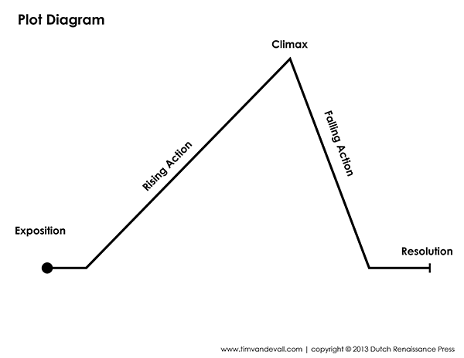
Structuring Stories
Act One – The Setup
Lay the groundwork
Act Two – Rising Action
The meat of the story
Capitalize on insight
Act Three – The Climax
The grand reveal
Call to action
Notes:
Like traditional stories, data stories have shape, or “structure.” Story structure plays an important role in developing a story’s context, and can be broken down into two parts: Story Plot and Story Genre.
The events of a story are its plot (this is also called its storyline). These events generally relate to each other in a pattern or a sequence, and it’s the responsibility of the storyteller (or author) to arrange these actions in a meaningful way to shape the story. Like other forms of storytelling, the plot of a data story can be organized into a linear sequence or not—not all data stories are told in order, however they all have one thing in common: they must be true. Data stories are not inherently non-fiction.
The plot diagram is an organizational tool to help map events in a story. Its familiar triangle shape (representing the beginning, middle, and end) was described by Aristotle and later modified by Gustav Freytag who added rising and falling action. Those designed for traditional stories, data stories can be built using this same framework.
et’s review how this structure functions:
Act One—The Setup (or, the Exposition): This is where you, as the narrator, lay the groundwork for your story. It’s where you explain the purpose, introduce the plot, establish the characters and their relationships, and finish with your dramatic question or inciting incident. This is the catalyst; it’s the type of story you are telling. Are you going to explore a change over time? Zoom into detail on something that happened? This act ends with your hypothesis, or what question you are exploring or answering within your story.
Act Two—The Rising Action: This is the meat of your story. It’s where you combine plot, characters, and audience as you guide them through the data. In a film or play, this act typically depicts a protagonist’s attempt to resolve a problem or the escalation of an issue, and who experiences character development along the way. In a visual data narrative, this is your opportunity to perform a curated version of your own analysis, capitalizing on the insights you have found that support your narrative’s purpose—and making your audience believe in your discoveries as they experience the story for themselves.
Act Three—The Climax: Finally, you’ve reached your grand reveal. Your audience has absorbed the plot point and is ready for their call to action via a final viz that ends the story.

Slide 57
The Beginning
The setting: When and where does the story take place?
01
The main character: Who is driving the action?
02
The imbalance: Why is it necessary, what has changed?
03
The balance: What do you want to see happen?
04
The solution: How will you bring about the changes?
05
Beyond Bullet Points, Cliff Atkinson

Slide 58
Develop the situation or problem
Incorporate external context or comparison points.
Give examples that illustrate the issue.
Include data that demonstrates the problem.
Articulate what will happen if no action is taken or no change is made.
Discuss potential options for addressing the problem.
Illustrate the benefits of your recommended solution.
Make it clear to your audience why they are in a unique position to make a decision or drive action.
Beyond Bullet Points, Cliff Atkinson

Slide 59
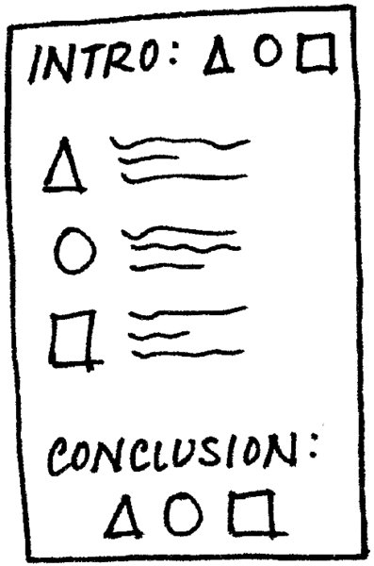
FINALLY CALL FOR ACTION

Slide 60
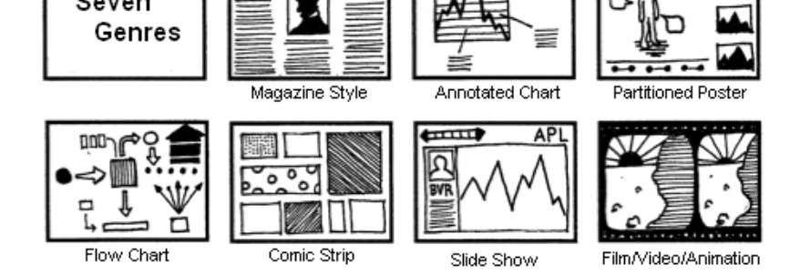
Structuring Stories
Notes:
The other half of story structure is its genre. Like the diversity in plot, there is more than one genre to choose from. In fact, there are seven genres of narrative visualization. Developed by Segel and Heel, they vary primarily in the number or frames and the ordering of visual elements and include the magazine style, the annotated chart, the partitioned poster, the flow chart, the comic strip, the slide short, and finally, the conglomerate film/video/animation (Figure 4.7).
he other half of story structure is its genre. Like the diversity in plot, there is more than one genre to choose from. In fact, there are seven genres of narrative visualization. Developed by Segel and Heel,³ they vary primarily in the number of frames and the ordering of visual elements and include the magazine style, the annotated chart, the partitioned poster, the flow chart, the comic strip, the slide short, and finally, the conglomerate film/video/animation (see Figure 4.7).
In Tableau, we can use Dashboards and Story Points to each of these genres, and we will explore how to build them in later lessons. For now, keep in mind that data stories are most effective when they have constrained interaction at various checkpoints and allow the user to explore and engage with the story without veering too far away from the intended narrative. Stories unfold, and each visualization should highlight one story point at a time (whether within the same visualizations or within multiple) as storytellers layer points to build a complete data narrative.

Slide 61
Where do I begin --?
Establishes a structure to your communication
Visually outlines the content you plan to create
Use a whiteboard, Post it notes or plain paper
3 minute story
if you only had 3 minutes what do they need to know.
Exploratory visual analysis

Slide 62
Three Minute Story
Boil it down to one big idea
So what?
It must articulate your unique point of view;
It must convey what’s at stake; and
It must be a complete sentence.

Slide 63

Session Focus
Visualization design principles and best practices

Slide 64
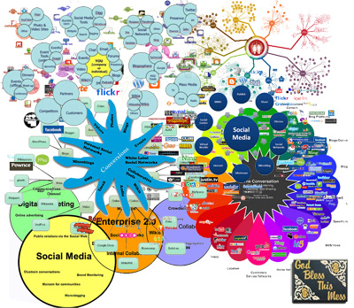

Slide 65

What is your visualization Pet Peeves?

Slide 66
Effective visualization
Employ simplicity
Display only the most important information
Require little explanation
Don’t Overload your data
Stay away from 3-D
Notes:
Here are a few rules to get you off to a fast start:
Employ simplicity. Simplicity is the key to creating effective data visualizations. You should focus on using simple charts that are easy to digest. You won't get points for most amount of data displayed.
Display only the most important information. When you're new to charting, you may want to put in a lot of information so that you don't leave out anything of value. Resist this urge, because people can take in only so much information before their eyes glaze over.
Require little explanation. Don't make things so complicated that your users require a manual to understand what you're trying to convey. If you can't get something at a glance, it's too complicated for your reader.
Don't overload your data. It's important to avoid overloading your data visualization, but the trend toward the use of mobile devices makes this practice even more important. Mobile devices reduce the screen real estate to almost half of what's available on a desktop. Typically, a visualization isn't manipulated on a mobile phone; it's only viewed.
Stay away from 3-D. At some point in your data career, you may become a whiz at depicting charts in 3-D. We recommend that you avoid this type of chart, however, until you get more experience under your belt.

Slide 67

The Three Essential Elements
Chart type
Color
Labels

Slide 68
How do Humans Like Their Data?
Categorical
Position
Different Color
Ordinal
Position
Size
Quantitative
Position
Length
Shape
Color Intensity
Different Colors
Shape
Size
Color Intensity
Notes:
Note that position is the best way across all 3 types of data. We can easily understand the relationship between two data points represented on an x and y axis.

Slide 69

Chart Selection
Which chart is right for your viz?

Slide 70
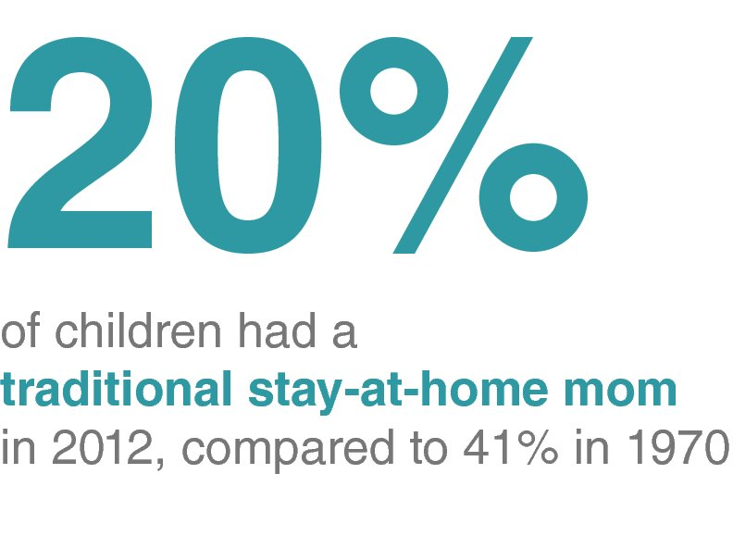
Simple Text
WHEN TO USE:
You have a number or 2 to share
The number simply does not need to be graph

Slide 71
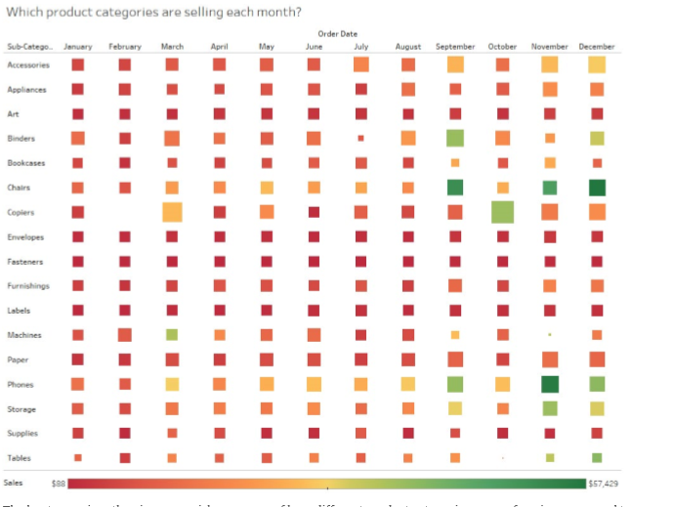
Heat Maps
WHEN TO USE:
Compare categorical data using color
Heat maps are best for presenting data sets with lots of categories.
https://www.everydayhealth.com/flu/map/
Notes:
Heat maps
Heat maps are a great way to compare data across two or more categories using color. Patterns guide viewers around the chart, quickly showing them where the intersection of categories is strongest and weakest.
Use heat maps to:
• Compare categorical data using color. Heat maps are best for presenting data sets with lots of categories. This chart type can pack hundreds of comparisons into a small area, and still be easy to understand at a glance. For example, sales quota assessment, actual spending vs. budget, and performance spectrum (great/good/poor).
Tips:
• Vary the size of squares. Changing the size of the squares adds significance to the heat map’s visual analysis. For example, shrinking a square creates whitespace around it, deemphasizing it and directing the viewer’s eye elsewhere.
To discover more tips for optimizing your dashboard layout, read The Do’s and Don’ts of Dashboards.

Slide 72
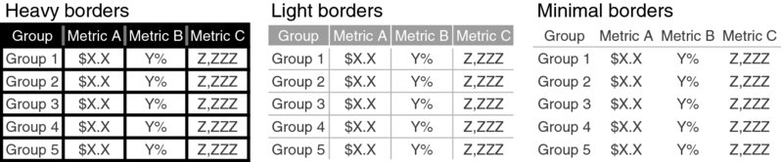
Tables
Rarely a good idea
Notes:
Using a table in a live presentation is rarely a good idea. As your audience reads it, you lose their ears and attention to make your point verbally. When you find yourself using a table in a presentation or report, ask yourself: what is the point you are trying to make? Odds are that there will be a better way to pull out and visualize the piece or pieces of interest. In the event that you feel you’re losing too much by doing this, consider whether including the full table in the appendix and a link or reference to it will meet your audience’s needs.

Slide 73
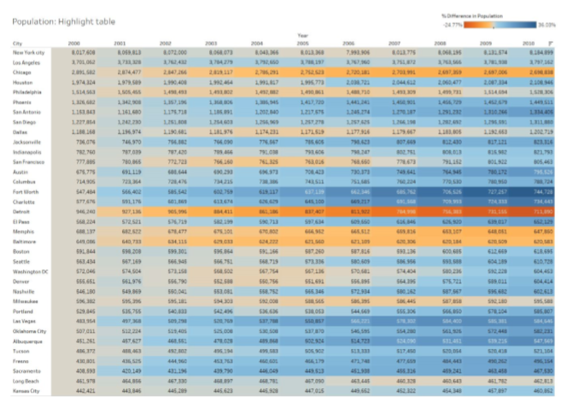
Highlight Table
encodes a data table using color to highlight the differences in the table numbers.
Notes:
A highlight table is simple a table of numbers that add color to highlight the differences in the values in the table.
Highlight data shows numbers in cells providing additional information.
Draws attention to detailed information. Highlight tables graphs viewer attention, while still presenting precise figures.

Slide 74
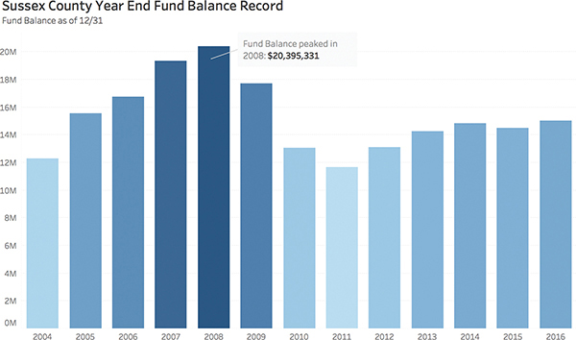
Bar Charts
Bar Charts
A bar chart displays a numeric value against another categorical (discrete) variable
The bars are scaled automatically to display the range of all the values in the dataset.
Can be both vertical or horizontal
Notes:
bar chart (see Figure 1.28) uses length to represent a measure. Human beings are extremely good at seeing even small differences in length from a common baseline. Bars are widely used in data visualization because they are often the most effective way to compare categories. Bars can be oriented horizontally or vertically. Sorting them can be very helpful because the most common task when bar charts are used is to spot the biggest/smallest items.
traditional favorite, the bar chart is one of the most common ways to visualize data. It is best suited for numerical data that can be divided into distinct categories to compare information and reveal trends at a glance (see Figure 5.1).
An old classic, there are a few ways to spice up a bar chart.
Bars can be oriented on the vertical or horizontal axis, which can be helpful for spotting trends.
Additional layers of information can be added using clustered bars or by stacking related data.
Color can be added for more impact or to overlay for immediate insight.
Trend lines and other annotations can be added to highlight important data points.
Use side-by-side or stacked bars (see Figure 5.2) to give depth to your analysis and answer multiple questions at once.
Bar charts can be combined with maps or line charts to act as filters that correspond to different data points as they are selected.
Finally, multiple bar charts could be set on a dashboard to help viewers quickly compare information without navigating several charts.

Slide 75
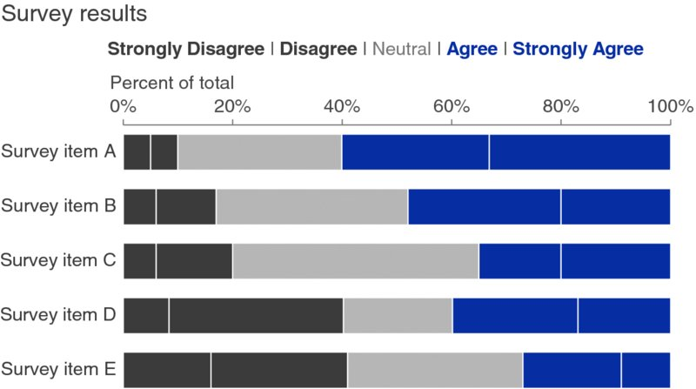
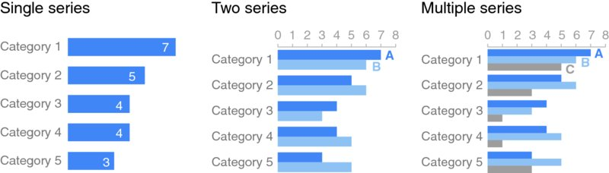
Horizontal Bar
Notes:
If I had to pick a single go-to graph for categorical data, it would be the horizontal bar chart, which flips the vertical version on its side. Why? Because it is extremely easy to read. The horizontal bar chart is especially useful if your category names are long, as the text is written from left to right, as most audiences read, making your graph legible for your audience. Also, because of the way we typically process information—starting at top left and making z’s with our eyes across the screen or page—the structure of the horizontal bar chart is such that our eyes hit the category names before the actual data. This means by the time we get to the data, we already know what it represents (instead of the darting back and forth our eyes do between the data and category names with vertical bar charts).
Like the vertical bar chart, the horizontal bar chart can be single series, two series, or multiple series (Figure 2.18).
Similar to the stacked vertical bar chart, stacked horizontal bar charts can be used to show the totals across different categories but also give a sense of the subcomponent pieces. They can be structured to show either absolute values or sum to 100%.
I find this latter approach can work well for visualizing portions of a whole on a scale from negative to positive, because you get a consistent baseline on both the far left and the far right, allowing for easy comparison of the left-most pieces as well as the right-most pieces. For example, this approach can work well for visualizing survey data collected along a Likert scale (a scale commonly used in surveys that typically ranges from Strongly Disagree to Strongly Agree), as shown in Figure 2.19.

Slide 76
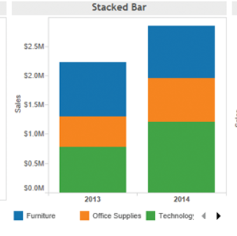
Stacked Bar
Stacked vertical bars are more limited.
Use to compare totals across categories
See the subcomponent pieces within a given category.
Can easily become overwhelming.
May want to limit the number of bars and categories.

Slide 77
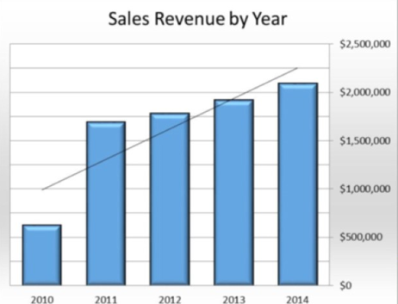
Trend Lines
Indicate relationships between values
Highlight any trend they may exist.

Slide 78
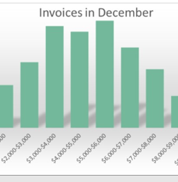
Histogram
Frequency distribution of continuous variables
Bar width is a range of values (BINS)
Bar height is frequency
Notes:
Histograms show how your data is distributed across distinct groups. By grouping your data into specific categories (also known as “bins”), then plotting the number of records in a category as a vertical bar, you can quickly see which bins the majority of your data falls in.
Use histograms to:
• Understand the distribution of your data. The histogram is your best option for visualizing how data falls into categories. For example, number of customers by company size, student performance on an exam, and frequency of a product defect.
Tips:
• Test different groupings of data. Creating a variety of histograms can help to determine the most useful groupings of data.
• Add color to break bins down. Apply color to bars representing each group to show a second set of categories on the same chart.

Slide 79
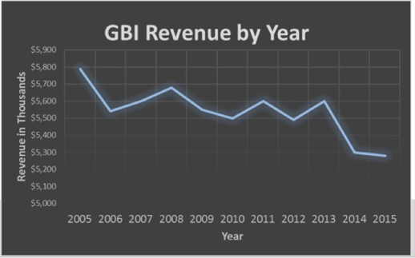
Line Charts
Used most often for times series
Data points are connected
Used to show trends over time
Notes:
The line chart, or line graph, is another familiar method for displaying data. It connects several distinct data points, presenting them as one continuous evolution. The result is a simple, straightforward way to visualize changes in one value relative to another.
Use line charts to:
• View trends in data, usually over time. Line charts are most often used to show a value evolving over time, but they aren’t limited to that. Any dimension—like date types, time intervals, and other ordinal data—can be used as the horizontal axis. For example, stock price change over five years, website page views during a month, and revenue growth by quarter.
Tips:
• Combine a line graph with bar charts. Bar and line charts go well together. Showing two kinds of information on the same axis adds powerful context to your data.
• Shade the area under lines. Shading the area under line charts provides an immediate visual cue of quantity, and can improve the look and feel of your graph. When your graph includes multiple lines, use multiple colors to inform the viewer of each line’s relative contribution to the whole.

Slide 80
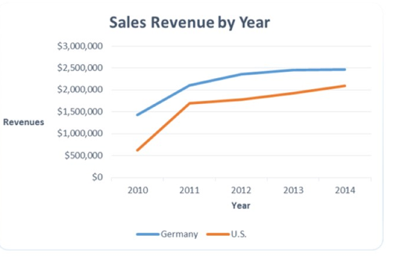
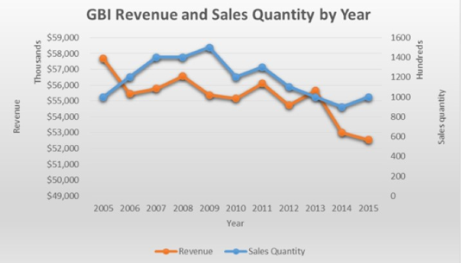
Line Charts – Multiple Variables
Multiple categories
Second Axis to show multiple variables

Slide 81
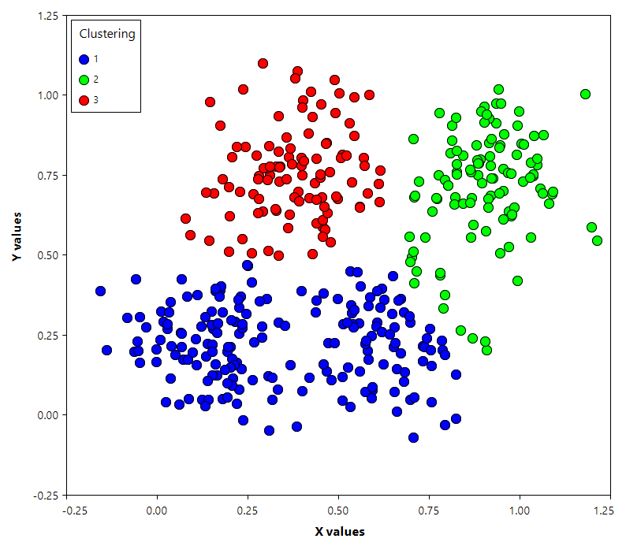
Scatterplots
Plots independent versus dependent variables
Each data point is represented
May indicate correlation between the two variables
Cluster analysis helps identify segments
Notes:
Scatter plots are an effective way to give you a sense of trends, concentrations, and outliers that facilitate deeper investigations of your data. A scatter plot presents lots of distinct data points on a single chart. The chart can then be enhanced with analytics like cluster analysis or trend lines.
Use scatter plots to:
• Investigate the relationship between different variables. Scatter plots are used to show if one variable is a good predictor of another, or if they tend to change independently. This type of chart easily lends itself to many types of analysis. For example, male versus female likelihood of having lung cancer at different ages, technology early adopters’ and laggards’ purchase patterns of smart phones, and shipping costs of different product categories to different regions.
Tips:
• Use cluster analysis to identify segments. Cluster analysis groups data points into distinct segments, based on the variables you select.
• Use highlight actions. By adding a highlight action to your scatter plots, quickly see which points have attributes in common, without losing sight of the rest of the dataset.
• Use custom mark types. Custom marks add a quick visual cue to your chart, clearly distinguishing different groups of points.

Slide 82
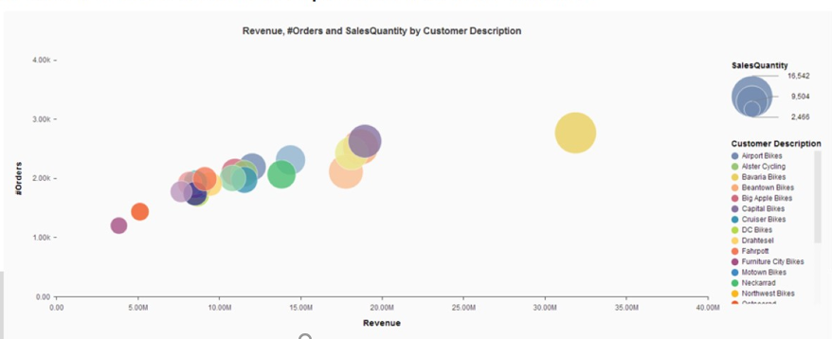
Bubble Chart
Circle represent data points
Extension of a scatterplot
Size of bubble represent value of a third variable
Bubbles can be color coded to represent a fourth variable
Notes:
Although bubbles aren’t technically their own type of visualization, using them as a technique adds great detail to scatter plots or maps. Varying the size and color of circles creates visually compelling charts that present large volumes of data at once.
Use bubble charts to:
• Show the relationship between three or more measures. Bubbles can add more detail to the traditional two axis chart, highlighting the relationship between three or more variables, without overwhelming the viewer.
Tips:
• Add color. Color can add more dimension to a bubble chart, while creating an attractive visual “pop.”
• Overlay bubbles on maps. Bubbles quickly inform a viewer about relative concentration of data. Using these as an overlay puts geographically-related data in context quickly for the

Slide 83
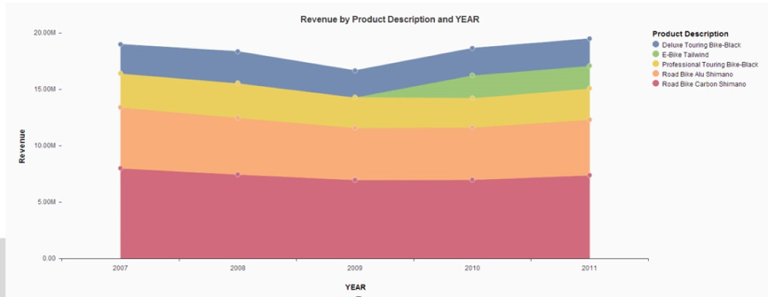
Area chart
Enhanced line chart
Area under line filled with color to represent cumulative totals
Using multiple lines represent each value in the legend conveys the comparative total of those variables.

